Slide 1
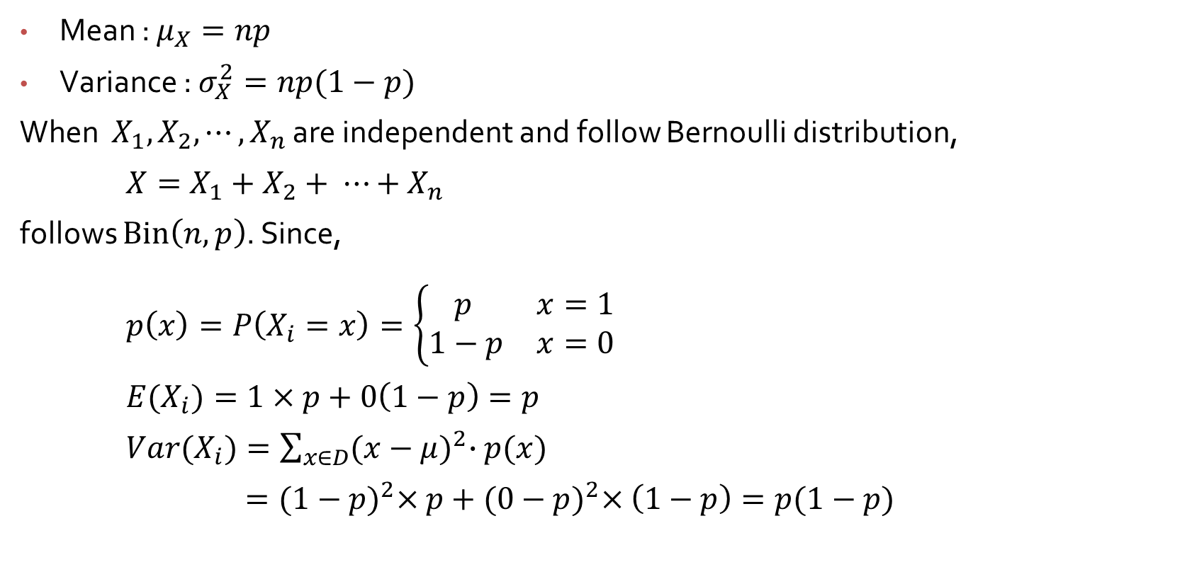
Binomial R.V. Mean and Variance
Mean : $μ_{X}=np$
Variance : $σ_{X}^{2}=np(1−p)$
When $X_{1}, X_{2}, ⋯,X_{n}$ are independent and follow Bernoulli distribution,
$X=X_{1}+X_{2}+ ⋯+X_{n}$
follows $Bin\left(n, p\right)$. Since,
$p\left(x\right)=P\left(X_{i}=x\right)=\left\{\begin{matrix}p & x=1 \\ 1−p & x=0\end{matrix}\right.$
${E(X}_{i})=1×p+0\left(1−p\right)=p$
${Var(X}_{i})=\sum_{x∈D}{{(x−μ)}^{2}∙p(x)}$
$={(1−p)}^{2}×p+{(0−p)}^{2}×\left(1−p\right)=p(1−p)$

Slide 2

Binomial R.V. Mean and Variance
Therefore,
$E\left(X\right) =E\left(X_{1}+X_{2}+ ⋯+X_{n}\right)$
$={E(X}_{1})+{E(X}_{2})+⋯+{E(X}_{n})=np$
$Var\left(X\right)=Var\left(X_{1}+X_{2}+ ⋯+X_{n}\right)$
$={Var(X}_{1})+{Var(X}_{2})+⋯+{Var(X}_{n})=np(1−p)$

Slide 3
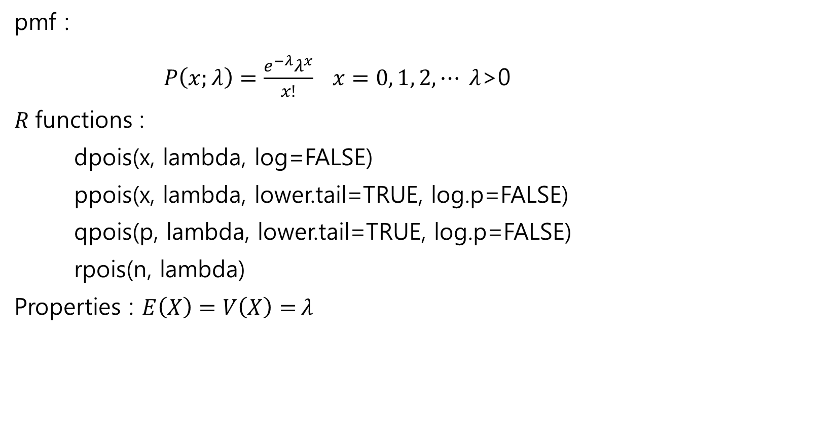
Poisson distribution
pmf :
$P\left(x;λ\right)=\frac{e^{−λ}λ^{x}}{x!} x=0, 1, 2, ⋯ λ$>0
$R$functions :
dpois(x, lambda, log=FALSE)
ppois(x, lambda, lower.tail=TRUE, log.p=FALSE)
qpois(p, lambda, lower.tail=TRUE, log.p=FALSE)
rpois(n, lambda)
Properties : $E\left(X\right)=V\left(X\right)=$ $λ$

Slide 4
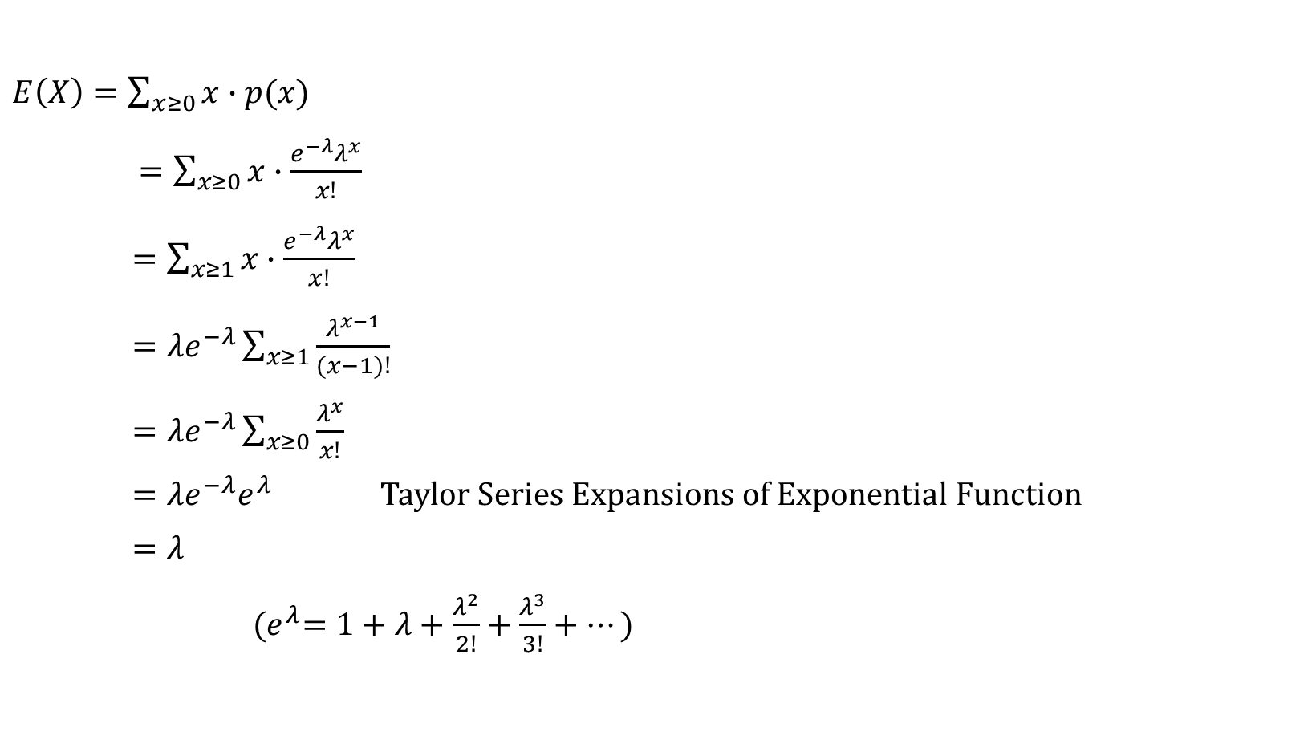
E(X) of Poisson distribution
$E\left(X\right)=\sum_{x≥0}{x∙p(x)}$
$=\sum_{x≥0}{x∙\frac{e^{−λ}λ^{x}}{x!}}$
$=\sum_{x≥1}{x∙\frac{e^{−λ}λ^{x}}{x!}}$
$=λe^{−λ}\sum_{x≥1}{\frac{λ^{x−1}}{(x−1)!}}$
$=λe^{−λ}\sum_{x≥0}{\frac{λ^{x}}{x!}}$
$=λe^{−λ}e^{λ}$ Taylor Series Expansions of Exponential Function
$=λ$
${(e}^{λ}=1+λ+\frac{λ^{2}}{2!}+\frac{λ^{3}}{3!}+⋯)$

Slide 5

V(X) of Poisson distribution
$V\left(X\right)=E\left[X^{2}\right]−{\left[E\left(X\right)\right]}^{2}$
$=E[X\left(X−1\right)+X]$ $−{\left[E\left(X\right)\right]}^{2}$
$=E[X\left(X−1\right)]+E[X]$ $−{\left[E\left(X\right)\right]}^{2}=λ^{2}+$ $λ−λ^{2}=$ $λ$
$E[X\left(X−1\right)]=\sum_{x≥0}{x(x−1)∙p(x)}$
$=\sum_{x≥0}{x(x−1)∙\frac{e^{−λ}λ^{x}}{x!}}$
$=\sum_{x≥2}{x(x−1)∙\frac{e^{−λ}λ^{x}}{x!}}$
$=λ^{2}e^{−λ}\sum_{x≥2}{\frac{λ^{x−2}}{(x−2)!}}$
$=λ^{2}e^{−λ}\sum_{x≥0}{\frac{λ^{x}}{x!}}$
$=λ^{2}e^{−λ}e^{λ}=λ^{2}$

Slide 6
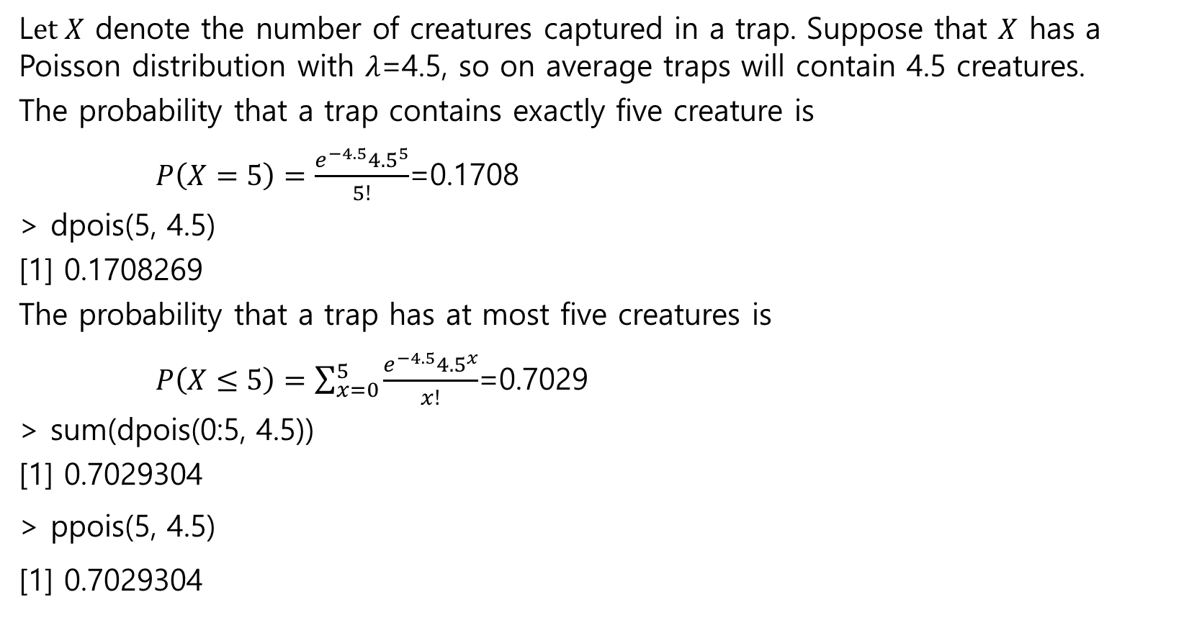
Example 3.39
L$et X$ denote the number of creatures captured in a trap. Suppose that $X$ has a Poisson distribution with $λ$=4.5, so on average traps will contain 4.5 creatures.
The probability that a trap contains exactly five creature is
$P\left(X=5\right)=\frac{e^{−4.5}{4.5}^{5}}{5!}$=0.1708
> dpois(5, 4.5)
[1] 0.1708269
The probability that a trap has at most five creatures is
$P\left(X≤5\right)=\sum_{x=0}^{5}{\frac{e^{−4.5}{4.5}^{x}}{x!}}$=0.7029
> sum(dpois(0:5, 4.5))
[1] 0.7029304
> ppois(5, 4.5)
[1] 0.7029304

Slide 7

Approximating binomials
Formal statement : In the binomial probability mass function if $n→∞$ and $p↓0$ in such a way that $np$ approaches a finite value $λ$ then
$b\left(x;n, p\right)→p\left(x; λ\right)$
Practical application : For $n$ large and $p$ small you can approximate the binomial with the Poisson by setting $λ=np.$ (This is not necessary in $R$)

Slide 8
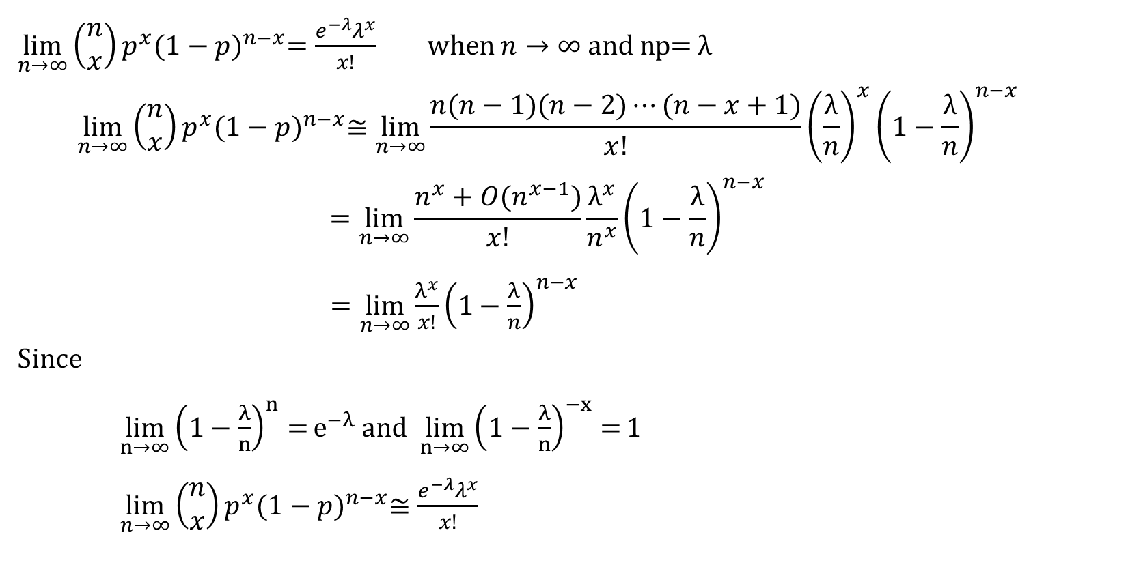
Poisson limit theorem
$\lim_{n→∞}\left(\begin{matrix}n \\ x\end{matrix}\right)p^{x}{(1−p)}^{n−x}=\frac{e^{−λ}λ^{x}}{x!}$ when $n→∞ and n$p= $λ$
$$\lim_{n→∞}\left(\begin{matrix}n \\ x\end{matrix}\right)p^{x}{(1−p)}^{n−x}≅\lim_{n→∞}{\frac{n(n−1)(n−2)⋯(n−x+1)}{x!}}{\left(\frac{λ}{n}\right)}^{x}{\left(1−\frac{λ}{n}\right)}^{n−x}$$
$$=\lim_{n→∞}{\frac{n^{x}+O(n^{x−1})}{x!}}\frac{λ^{x}}{n^{x}}{\left(1−\frac{λ}{n}\right)}^{n−x}$$
$=\lim_{n→∞}{\frac{λ^{x}}{x!}{\left(1−\frac{λ}{n}\right)}^{n−x}}$
Since
$\lim_{n→∞}{{\left(1−\frac{λ}{n}\right)}^{n}=}e^{−λ}$ and $\lim_{n→∞}{{\left(1−\frac{λ}{n}\right)}^{−x}=}1$
$\lim_{n→∞}\left(\begin{matrix}n \\ x\end{matrix}\right)p^{x}{(1−p)}^{n−x}≅\frac{e^{−λ}λ^{x}}{x!}$

Slide 9
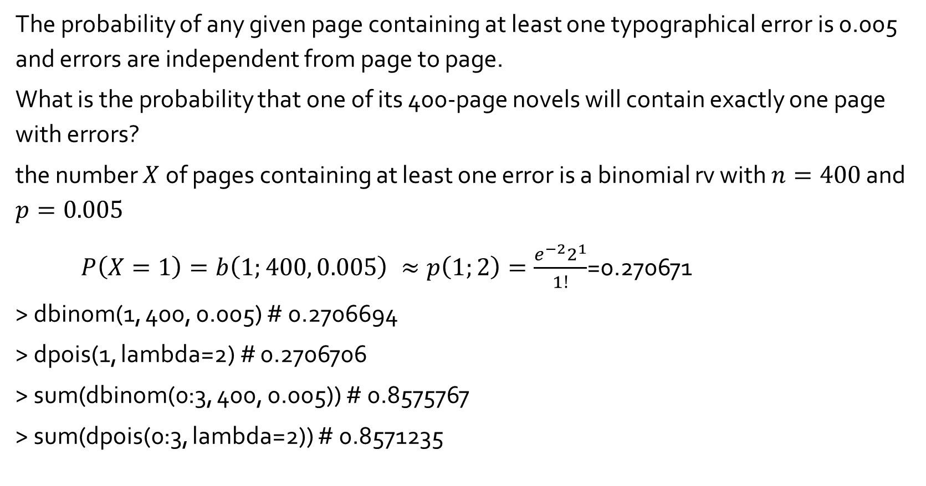
Example 3.40
The probability of any given page containing at least one typographical error is 0.005 and errors are independent from page to page.
What is the probability that one of its 400-page novels will contain exactly one page with errors?
the number $X$of pages containing at least one error is a binomial rv with $n=400$ and $p=0.005$
$P\left(X=1\right)=b\left(1;400, 0.005\right) ≈p\left(1;2\right)=\frac{e^{−2}2^{1}}{1!}$=0.270671
> dbinom(1, 400, 0.005) # 0.2706694
> dpois(1, lambda=2) # 0.2706706
> sum(dbinom(0:3, 400, 0.005)) # 0.8575767
> sum(dpois(0:3, lambda=2)) # 0.8571235

Slide 10
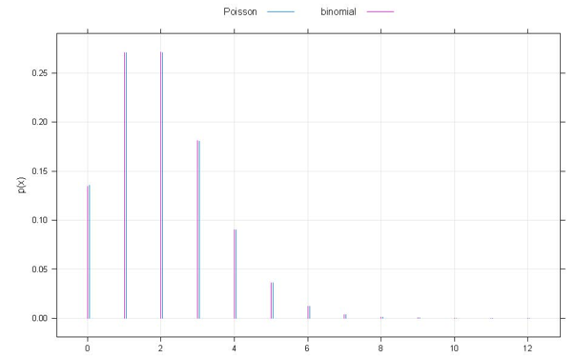
Comparison plot of binomial and Poisson approximation

Slide 11
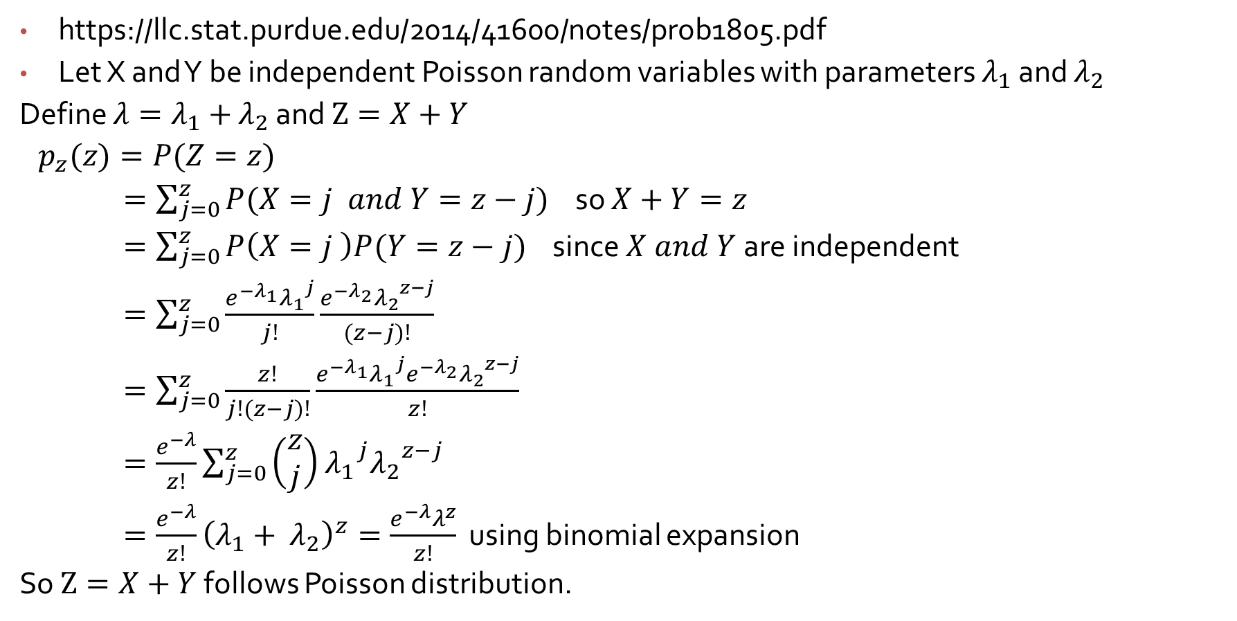
Sums of independent Poisson random variables
https://llc.stat.purdue.edu/2014/41600/notes/prob1805.pdf
Let X and Y be independent Poisson random variables with parameters $λ_{1}$ and $λ_{2}$
Define ${λ=λ}_{1}+$ $λ_{2}$ and $Z=X+Y$
$p_{z}(z)=P(Z=z)$
$=\sum_{j=0}^{z}{P(X=j and Y=z−j)}$ so $X+Y=z$
$=\sum_{j=0}^{z}{P\left(X=j \right)P(Y=z−j)}$ since $X and Y$are independent
$=\sum_{j=0}^{z}{\frac{e^{−λ_{1}}{λ_{1}}^{j}}{j!}\frac{e^{−λ_{2}}{λ_{2}}^{z−j}}{(z−j)!}}$
$=\sum_{j=0}^{z}{\frac{z!}{j!(z−j)!}\frac{e^{−λ_{1}}{λ_{1}}^{j}e^{−λ_{2}}{λ_{2}}^{z−j}}{z!}}$
$=\frac{e^{−λ}}{z!}\sum_{j=0}^{z}{\left(\begin{matrix}z \\ j\end{matrix}\right)}$ ${λ_{1}}^{j}{λ_{2}}^{z−j}$
$=\frac{e^{−λ}}{z!}{\left(λ_{1}+ λ_{2}\right)}^{z}=\frac{e^{−λ}λ^{z}}{z!}$ using binomial expansion
So $Z=X+Y$ follows Poisson distribution.

Slide 12
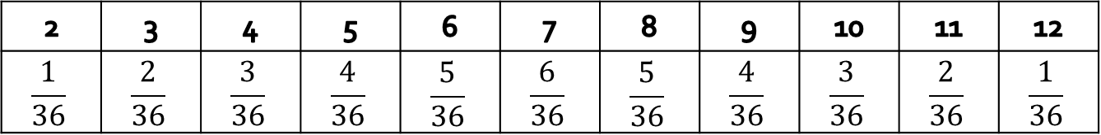
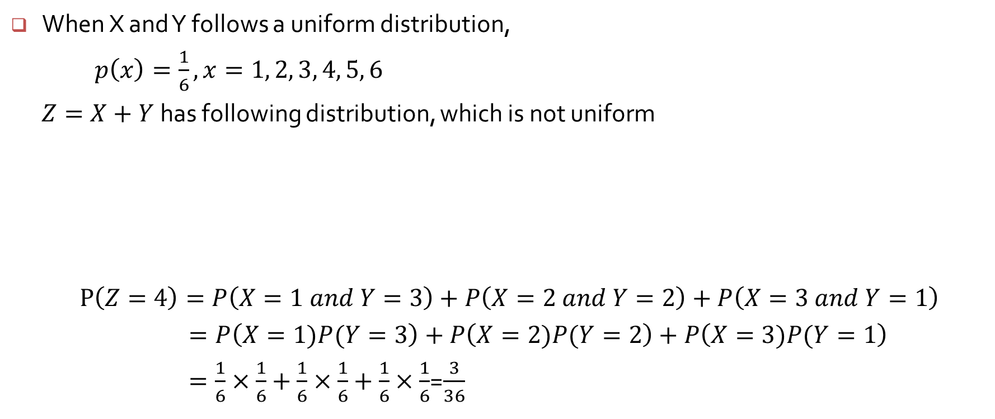
When X and Y follows a uniform distribution,
$p\left(x\right)=\frac{1}{6}, x=1, 2, 3, 4, 5, 6$
$Z=X+Y$has following distribution, which is not uniform
$P\left(Z=4\right)=P\left(X=1 and Y=3\right)+P\left(X=2 and Y=2\right)+P\left(X=3 and Y=1\right)$
$=P\left(X=1)P(Y=3\right)+P\left(X=2)P(Y=2\right)+P\left(X=3)P(Y=1\right)$
$=\frac{1}{6}×\frac{1}{6}+\frac{1}{6}×\frac{1}{6}+\frac{1}{6}×\frac{1}{6}$=$\frac{3}{36}$
2 | 3 | 4 | 5 | 6 | 7 | 8 | 9 | 10 | 11 | 12
$$\frac{1}{36}$$ | $$\frac{2}{36}$$ | $$\frac{3}{36}$$ | $$\frac{4}{36}$$ | $$\frac{5}{36}$$ | $$\frac{6}{36}$$ | $$\frac{5}{36}$$ | $$\frac{4}{36}$$ | $$\frac{3}{36}$$ | $$\frac{2}{36}$$ | $$\frac{1}{36}$$

